Slide 1

University Institute of Liberal Arts and Humanities
Course Name – Communication Skills
Course Code – 23PCH-105
Business letters
DISCOVER . LEARN . EMPOWER

Slide 2
COURSE OBJECTIVES
The Course aims to:
1 | Augment students overall communication and interpersonal skills by making them realize the importance of good oral and written English Language in professional life.
2 | Enrich their reading capability with special emphasis on expanding vocabulary and grammatical formations.
3 | Build exceptional speaking, reading and writing skills by correcting grammatical errors and pronunciation through practice.
4 | Enhances soft skills by fostering self awareness, confidence and a positive attitude in students’ ability to communicate effectively in English.

Slide 3
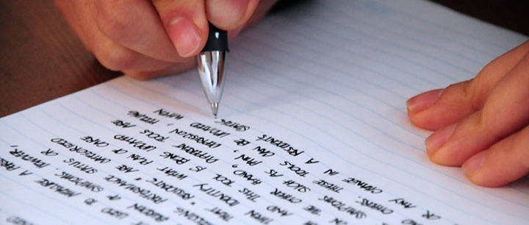
Course Outcomes
On completion, the students are expected to:
CO Number | Title | Level
CO1 | Apply appropriate Listening, Speaking, Reading and Writing Skills (LSRW Skills) with correct non-verbal cues to attain expertise in soft skills. | Apply
CO2 | Apply correct contextual and comprehensible written text in the form of paragraph writing, short compositions business correspondence, using logical support and argument in a wide range of communication situations. | Apply
CO3 | Demonstrate linguistic competence while speaking and during presentations through accuracy in grammatical usage, vocabulary, pronunciation and intonation. | Apply
CO4 | Evaluate information as critical readers, speakers and writers applying ethics in communication and being sensitive in cross cultural communication. | Evaluate
CO5 | Create original, digital content for websites, blogs, vlogs and personal social media profiles etc. | Create

Slide 4
Business Letters
Letter
The business letter is the basic means of communication between two companies.
Most business letters have a formal tone.
Letters may be created and sent as:
E mail or electronic submission
Hand- delivered transmissions
Regular mail transmission

Slide 5
Difference Between a Letter and an Application
A letter is common form of external communication. It can be either formal (also known as Business letters) or informal.
An application is a formal letter which can be used for applying for leave, job or any professional request.

Slide 6
Formal and Informal letters
Formal Letters | Informal Letters
Formal letters follow a particular format for writing. | Informal letters do not follow any specific format for writing.
To give a professional look, the formal letters need to be typed on the computer. | These letters can be hand written.
These are written to a formal entity like bank manager, news editor, government official etc. | These letters are written to friends, relatives or parents.

Slide 7
Letter Mechanics
Pronoun (Point of View)
The use of personal pronouns is important in letters . . . I, he, she, it, we, they, you.
It is perfected to shift our focus from “I” and “We” to “You” and “Your”. The you-attitude is recipient –centered.
Writer has to view things from the reader’s point of view.

Slide 8
Pronoun Point of view (cont.)
WE- attitude | YOU- attitude
We have received your letter of June 15 | Thank you for your letter of June15
I have five year’s experience as a sales executive | Five year’s practical experience as a sales executive will enable me to push up your sales.
We have shipped the two dozen steel racks you ordered | Your two dozen steel racks should reach you soon/with this letter.

Slide 9
Do’s and Dont’s of Letter Writing
DO write with the reader in mind.
DON'T become over-reliant on your computer's spelling/grammar checking facility.
DO keep writing as simple and succinct as possible.
DON'T be tempted to use sarcasm jokingly in written communication.
DO structure and organize your business writing.

Slide 10
DO’S AND DONT’S OF LETTER WRITING (CONTD.)
DON'T be careless when writing a recipient's name, gender, or professional title.
DO choose an appropriate tone for your business writing.
DON'T forget to include a call to action if a response is needed.
DO save your best-written documents as templates for future use.
DON'T be unprofessional in your writing.

Slide 11
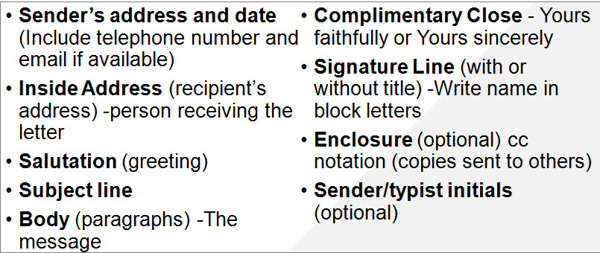
Parts of a Business Letter

Slide 12
Format of a Business Letter
There are three main styles of Business Letters:
Block style
Modified Block style
Semi-block style
The Block style format is the most popular.

Slide 13
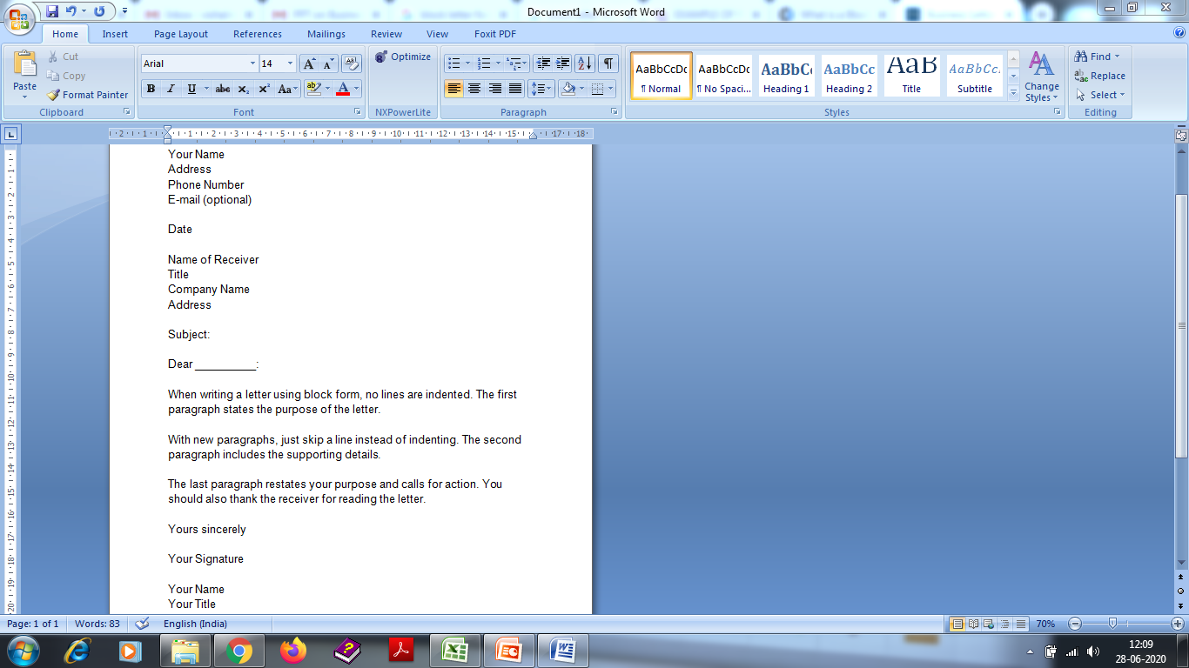
Block Style Letter Format
Sender’s Address
Date Line
Inside Address
Subject Line
Salutation
Main Body
Complimentary Close

Slide 14
Business Letter - Content
Body of the letter is the main content of the letter.
Split the body of long letters to smaller paragraphs..
The first paragraph should grab attention and state the reason for the letter.
The middle paragraphs must support your reason and go into details.

Slide 15
Business Letter – Content (cont.)
In the final paragraph request the recipient to take some kind of action. It includes ‘call for action’.
Use of Transitional words during writing the letters: However, so, therefore, thus, consequently etc. are some of the transitional words we use while shifting the paragraphs.
Do not leave room for ambiguity.

Slide 16
Business Letter – Content (cont.)
The closing of a business letter usually states ‘Sincerely,’ followed by three blank lines for the writer’s signature and then the writer’s typed name.

Slide 17
Kinds of Business Letters
There are many kinds of the business letters according to need:
Enquiry letter
Offer and Quotations
Order
Acknowledgement letters
Sales letters
Complaint and Adjustments
Collection Letters

Slide 18
Enquiry letter
Letters of enquiry describe what the writer wants and why.
Solicited enquiry: An enquiry made in response to the seller’s advertisement and publicity.
Unsolicited enquiry: An enquiry made the buyer’s own initiative.
Enquiry for some favor: An enquiry not about goods but about some other information, may be about some special price or some favorable terms.

Slide 19
Enquiry letter (cont.)
Opening statement :Suitable opening sentences in a letter of enquiry includes:
We shall be glad to receive details of your terms and conditions for the supply of the following items.
Closing statement: Suitable opening sentences in a letter of enquiry includes:
We look forward to your reply. If your terms are favourable, we will be pleased to send our order immediately.

Slide 20
Quotation Letters
After enquires, quotations, stating various term and conditions, are stated or sometimes offers are made.
While drafting letter of quotations consider the following points:
Reply promptly to quotations and orders made in response to enquiry.
Make reasonable offers that can persuade the other party to buy.
Be clear about the various terms used in quoting prices.

Slide 21
Order Letters
An order letter is also known as purchase letters.
Orders placed by letter should-
Give full details and quote catalogue number, if any.
Give full description of the date of delivery, mode of transportation etc.

Slide 22
Acknowledgement Letters
The receipt of the order should be acknowledged.
The letters bearing such acknowledgements are known as Acknowledgement letters.
This acknowledgement is a legal acceptance of all the mentioned points in the order letter.

Slide 23
Sales letter
A document designed to generate sales is known as Sales letter.
Influences the reader to take a specific action by making an offer.
Convinces the reader to place an order.
Uses the language of persuasion which is indirect approach.

Slide 24
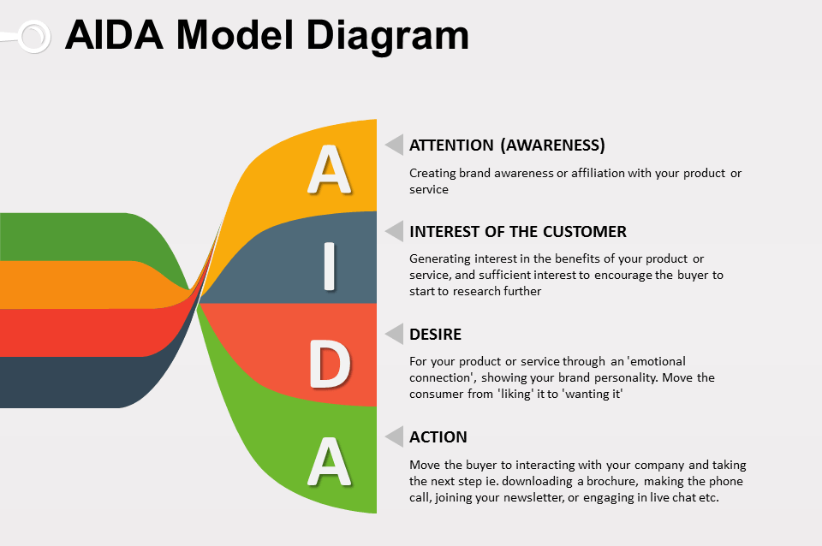
AIDA model for Sales letter
Attention: Attract the reader’s attention
Interest: Build the reader’s interest in the product or service
Desire: Create a desire in reader’s mind for the product or service
Action: Induce the reader to take an action in favour of product or service
www.pinterst.com

Slide 25
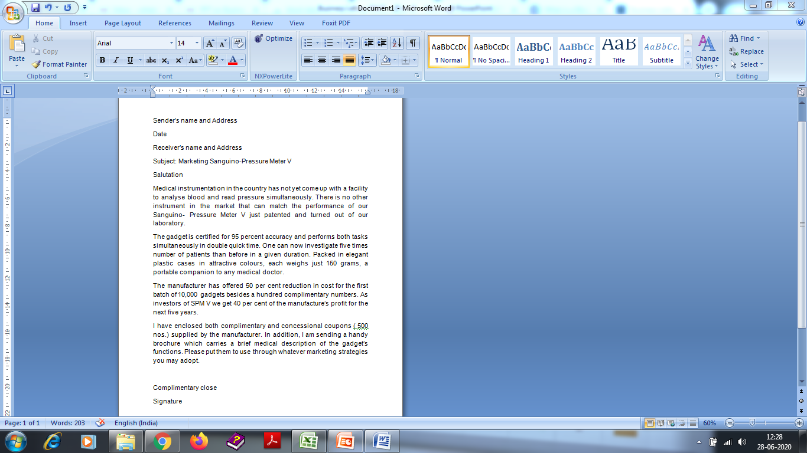
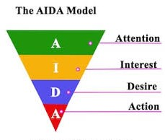
Sample Sales Letter
www.pinterst.com

Slide 26
Let’s Practice
You are a sales representative for your company. Write a letter to Mike Mason of ABC Enterprises, introducing one of your new products. Be sure to give important details about your product. Draft an AIDA letter.
You are the purchase officer for your company.Write a letter placing an order for office furniture, specifying the characteristics. Invent all the necessary details.

Slide 27
Applications
Applicable to both personal and professional life.
Will strengthen the Business letter writing skills of students.
Students will be able to write letters in a wide range of professional situations and will get an extra edge on their professional skills.

Slide 28
Assessment Pattern
Students are assessed on the basis of the following parameters:
Hourly Tests - 2
Assignments
Surprise Test
Quiz
Student Engagement
End Semester Exam

Slide 29
References
Bean,B.C.(2017),Business Correspondence. Forgotten Books.
Jovin,E. (2019). Writing for Business.
Lougheed,L. (2002).Business Correspondece: A Guide to Everyday Writing. Pearson Education ESL.
http://www.jfip
https://www.unioviedo.es/reunido/i
https://www.researchgate.net/journal/0021-9436_Journal_of_Business_Communication ndex.php/EBL/index s.com/joubuslet

